Slide 1

Optimized Routing for Cost Efficient Expansion
ENGR 693A
Aishwarya
Ana
Vishal

Slide 2
Introduction
Specific:
Data from 5 stores on the demand required for Baskin Robbins ice-creams.
Plan the route from the warehouse to each respective store.
Excel solver is used for taking inputs such as Vehicle Capacity, Time window of least traffic time, Delivery to every storefront at least ones during the journey.
Uniqueness:
Using the constraints that we have, it will be possible to come up with the shortest route, given the size of the vehicle.
It offers cost and productive savings
The same model can be deployed at other areas in the bay, in order to expand.

Slide 3
SME: Dr. G
Hypothesis:
Improved Demand Forecasting
Optimized Routing Decisions
Cost Savings
Scalability and Expansion
Anticipate demand spikes, plan inventory replenishment accordingly, and optimize delivery routes
Data collection
Subject Matter Expert
Received Approval 2/29!
No
Execution
Determining the goodness
Representation in Tableau
Navigational
Mapping
Using Excel solver for VRP
Data Collection from a selected areas of the Bay
Yes
Abstract
Introduction
Literature Review
Methodology
Results
Documentation
Completed
Document formatting
Conclusion
WIP
Yet to start

Slide 4
Responsibility Matrix
Responsibility | Aishwarya | Ana | Vishal
Topic Research
Data Collection
Solver/ Tableau
Report Writing
Technical Review

Slide 5
Literature Review
Reference | Topic | Method | Strength | Weakness
Dávila et al. (2021) | Vehicle Routing Problem with Deadline and Stochastic Service Times: Case of the Ice Cream Industry in Santiago City of Chile. | Tabu Search and Chaotic Search with Monte Carlo simulations | Effective in dealing with stochastic service times and optimizing routes, leading to cost savings and efficiency in delivery. | Longer resolution times, reduced maximum customer capacity, increased demands for distances and vehicles
Puspitasari et al. (2020) | Modeling the best route and truck capacity for delivering ice cream product | Vehicle Routing Problem, ECOST Method. | Optimizes truck capacity and routes for cost reduction, considering unique ice cream temperature requirements. | Solving the VRP model, particularly for large-scale distribution networks, can be computationally intensive and time-consuming.
Zhang & Chen (2014) | An Optimization Model for the Vehicle Routing Problem in Multi-product Frozen Food Delivery | Genetic Algorithm Heuristic | Optimizes frozen food delivery for cost-efficiency while maintaining freshness and safety. | The study doesn’t include complex assumptions, so there are real world factor that is not considered in the optimization model
Qin et al. (2019) | A Vehicle Routing Optimization Problem for Cold Chain Logistics Considering Customer Satisfaction and Carbon Emissions. | Cycle Evolutionary Genetic Algorithm (CEGA) | High cost-effectiveness and scientific validity, achieving 70% customer satisfaction with minimal cost increases | No customer satisfaction factor are included in the algorithm

Slide 6
Methodology
Capacity
Data Collection
Time window
Spreadsheet solver
Optimized Vehicle Route
Delivery at least ones in the route
Scalability

Slide 7
Tools used
Excel Spreadsheet Solver
Optimizes vehicle routes by organizing key data (locations, distances, capacities) in spreadsheets and employing algorithms to minimize travel distance and time, thus saving fuel and boosting service efficiency.
Tableau
Utilized to graphically represent the optimized delivery routes for Baskin Robbins ice-cream to suburban outlets, providing a clear, interactive map that highlights the most efficient pathways determined by the ExcelVRP solver.

Slide 8
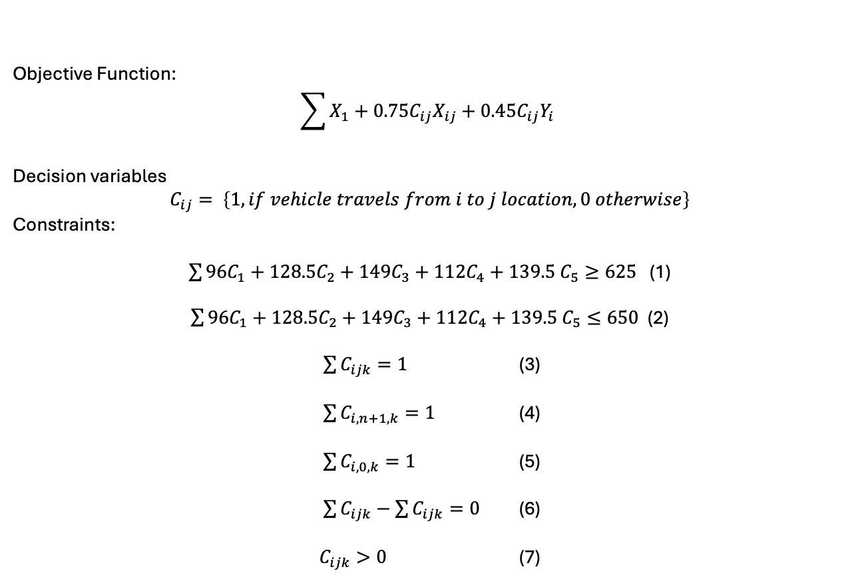
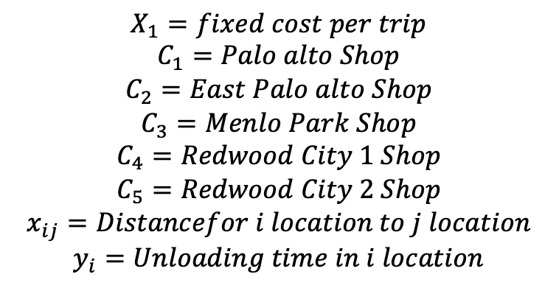
Algorithm
Demand constraint, at least meet the weekly demand
Capacity constraint, not exceed the capacity of the truck
Each location needs to be visited once
Route ends in depot n+1
Route starts in depot 0
The truck enter in i Location and departure i location
All variables needs to be positive

Slide 9
Shortest
Total Cost | 1004.98 |  | Optimal solution |  | 1004.975
Vehicle: | V1 | Stops: | 6 | Cost | 1004.98
Stop count | Location Name | Distance travelled | Driving time | Arrival time | Departure time | Working time | Profit collected | Load | Unloding Time
0 | Depot- Manteca | 0.00 | 0:00 |  | 00:00 | 0:00 | 0 | 270
1 | Redwood City 1 | 74.00 | 1:21 | 01:21 | 01:51 | 1:51 | 0 | 200 | 30
2 | Redwood City 2 | 75.70 | 1:26 | 01:56 | 02:41 | 2:41 | 0 | 145 | 45
3 | Menlo Park | 80.20 | 1:37 | 02:52 | 03:42 | 3:42 | 0 | 115 | 50
4 | Palo Alto | 84.20 | 1:48 | 03:53 | 04:33 | 4:33 | 0 | 55 | 40
5 | East Palo Alto | 87.30 | 1:57 | 04:42 | 05:17 | 5:17 | 0 | 0 | 35
6 | Depot- Manteca | 157.30 | 3:13 | 06:33 |  | 6:33 | 0 | 0
Detected reasons of infeasibility

Slide 10
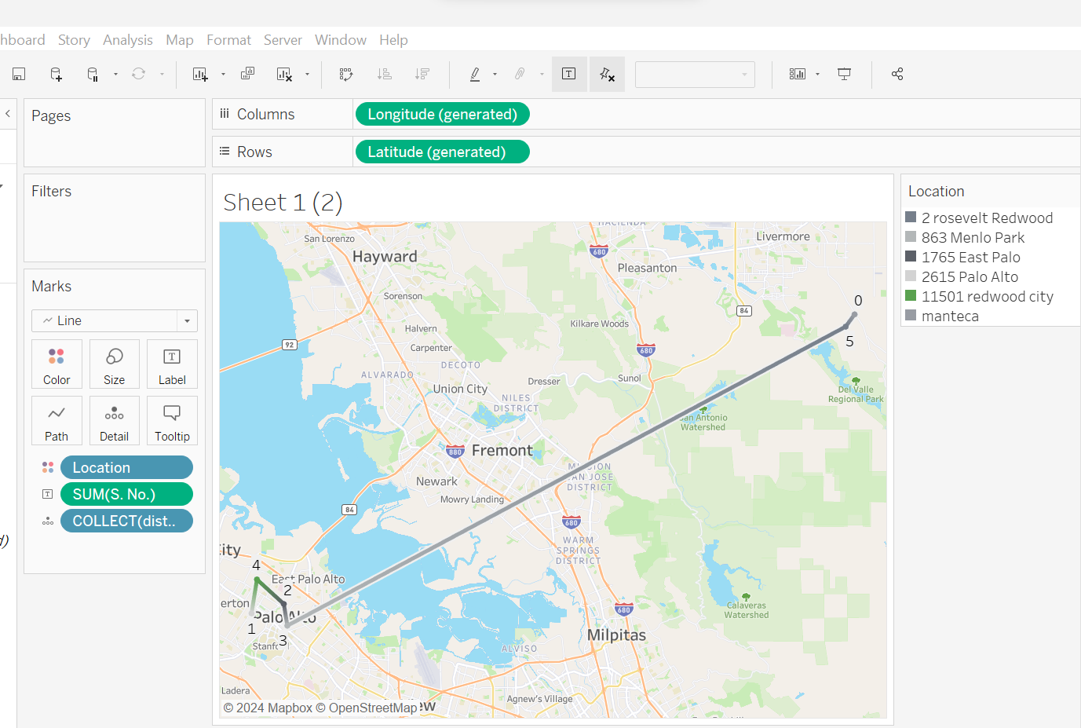
Tableau: Navigation Mapping

Slide 11
Outcome
Optimized cost of delivery routes to five suburban outlets.
Addressed multiple logistical constraints, ensuring efficient service and adherence to delivery schedules.
Demonstrated the solver's scalability and adaptability for potential broader geographic applications.
Additionally, expanding this solution from Redwood City stores to encompass the entire Bay Area is intended to demonstrate the potential for implementing scalable solutions that yield substantial savings for businesses such as Baskin Robbins.

Slide 12
Next Steps
Improvise tableau
Documentation

Slide 13
Thank you!

